Slide 1
Side channel attack
Samsung internship 2019

Slide 2
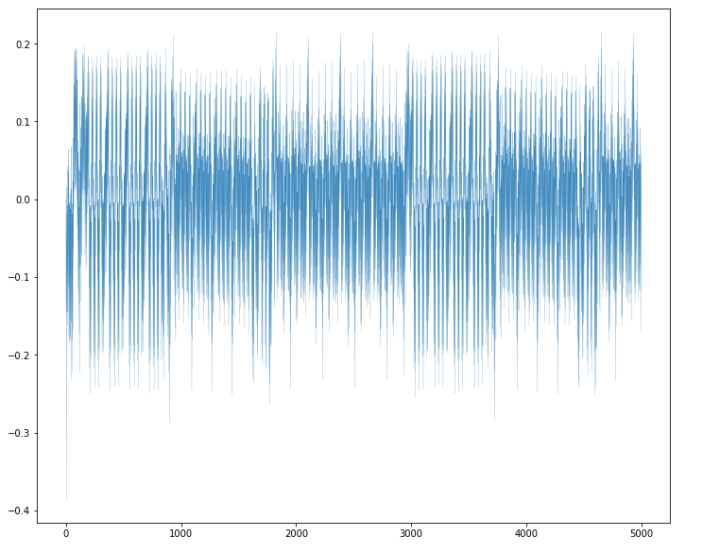
Task 1
Let there is any device doing AES protocol. You’ve got plaintext, ciphertext and traces of power consumption of this device. You need to rebuild the key of this protocol.
A piece of plaintext:
b'\x9c\x87\x07\x7f\x8do\xd5\xea\xa9\xbd\xc8o~\xd7\xea\xa4‘
A piece pf ciphertext: b'\xb3e<\x05i\xec\xb1\x8a\x83\xc8\x91\n\xcax%R'

Slide 3
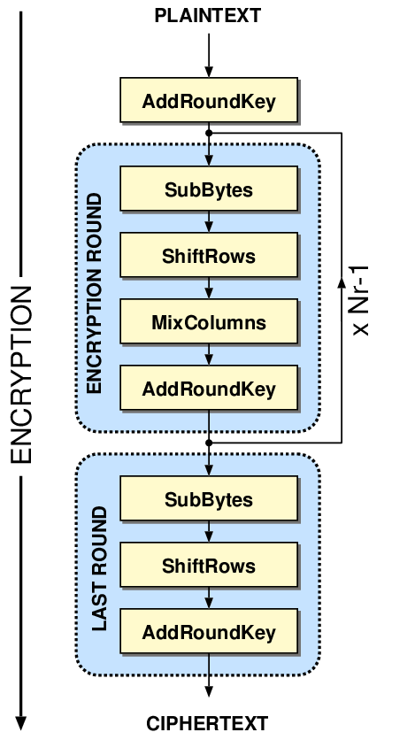
Research of traces (simple power analysis)
The first round:
Plaintext + AddRoundKey + SubBytes

Slide 4
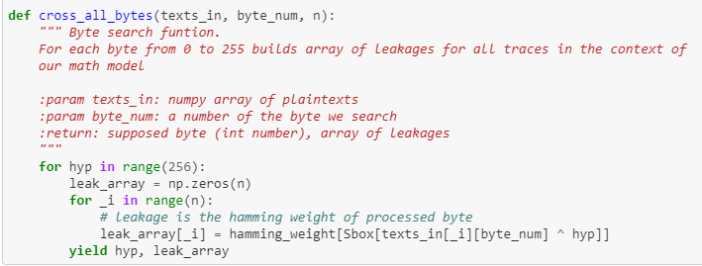
Correlation power analysis
Trace 1
Trace 2
Trace 3
Values of device power consumption in the moment of time

Slide 5
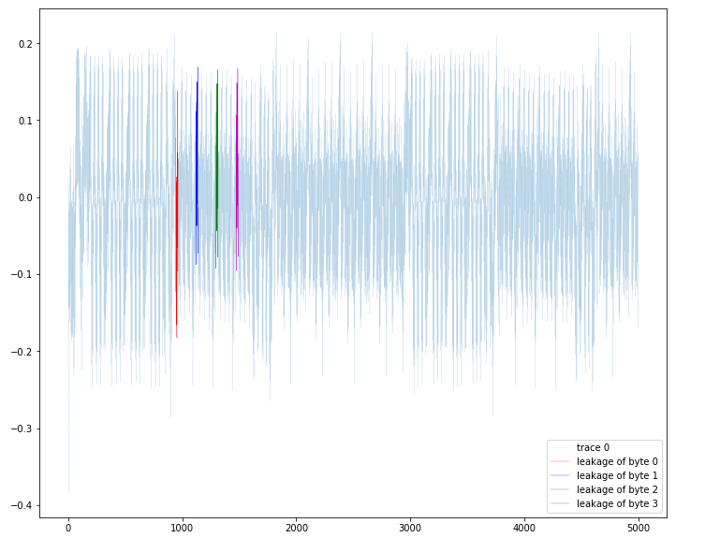
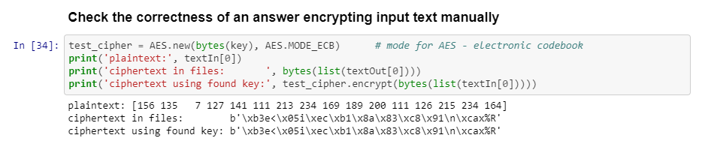
Results

Slide 6
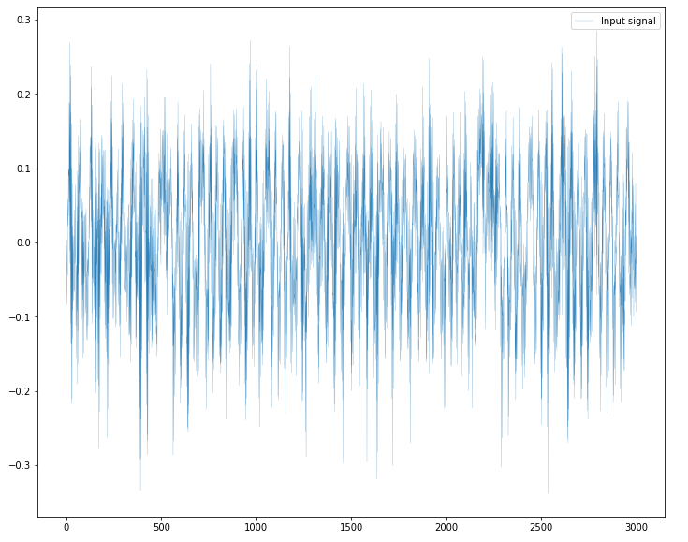
Task 2
There are two new problems:
- traces include noise
- traces show the last AES round

Slide 7

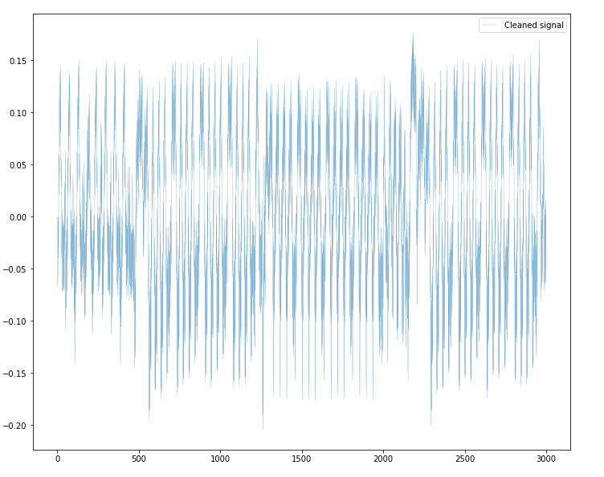
Cleaning
Return
cleaning
The last round:
Tmptext + AddRoundKey + SubBox = ciphertext

Slide 8
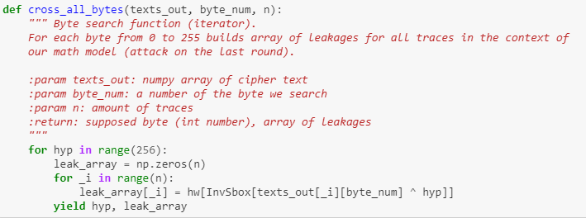
Model of the leakage (attack on the last round)
Target

Slide 9
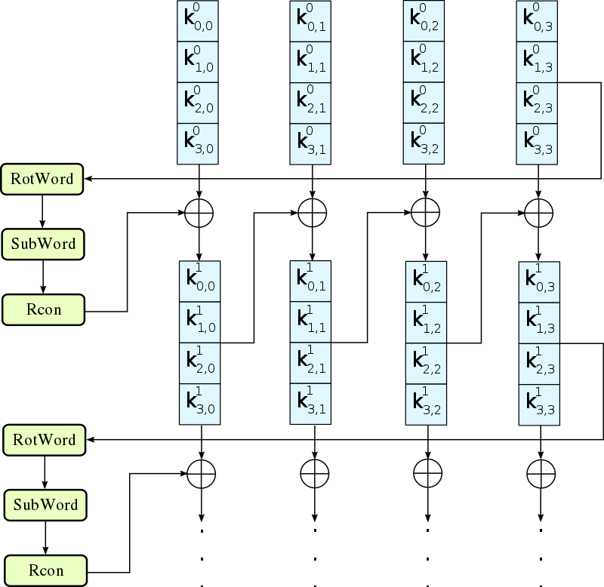

Key rebuilding
The main key
Round constants
Key expansion
Found key of the last round:
b'\xa0\x12\x02\x1a\xf5\x05+\xd8\x1a\x80\xc1\xd9\x06\x1c\xd9\xf0'
Round key
Result key:
TA|<3 T|-|3 R15k

Slide 10
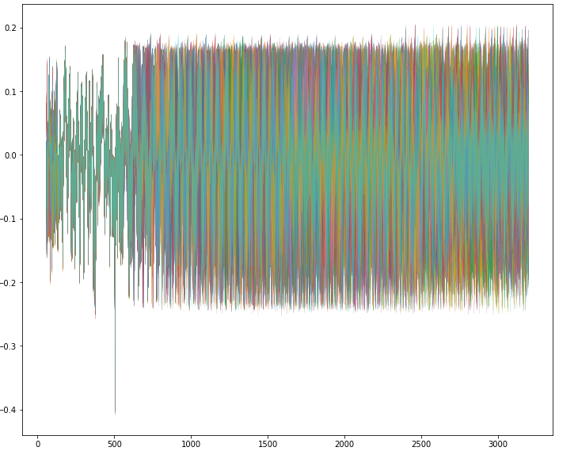
Task 3
Attack is doing on the first round like in task 1, but there is one new problem – traces aren’t aligned

Slide 11
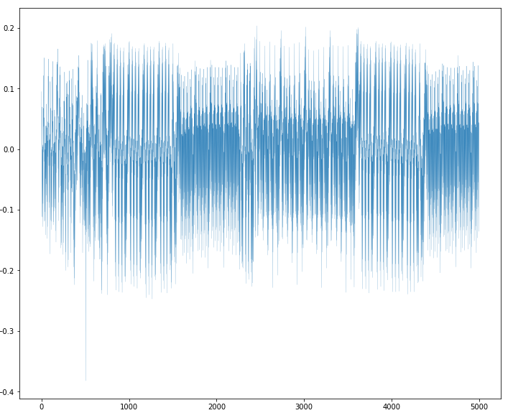
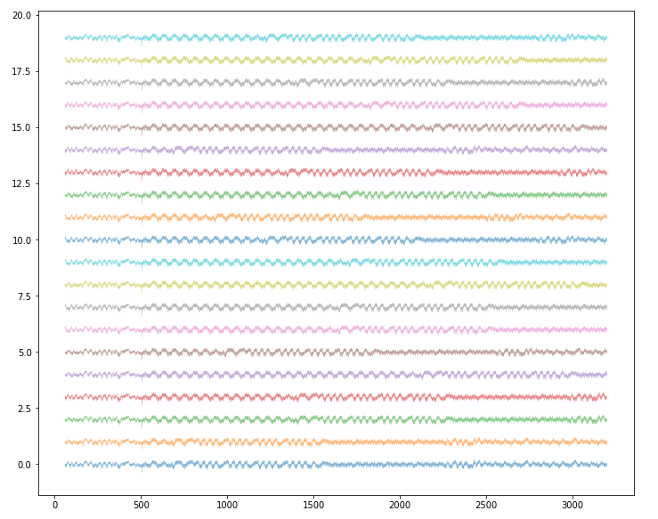
Alignment
The first 20 traces before alignment
trace 0
The place that there is on each traces

Slide 12
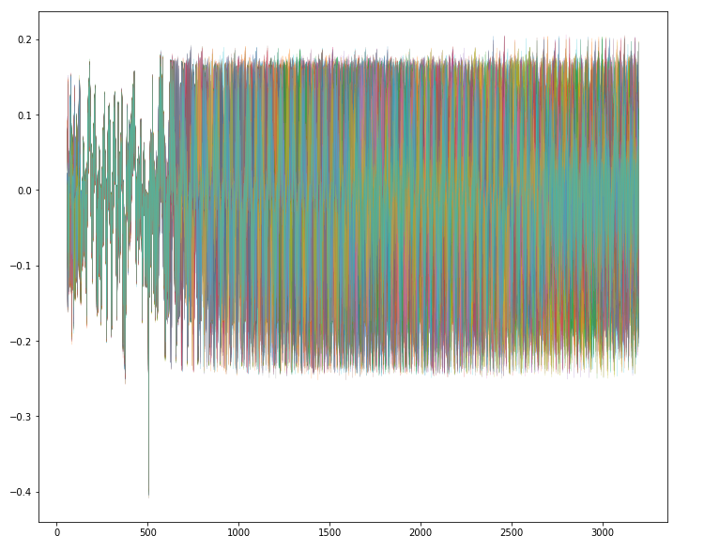
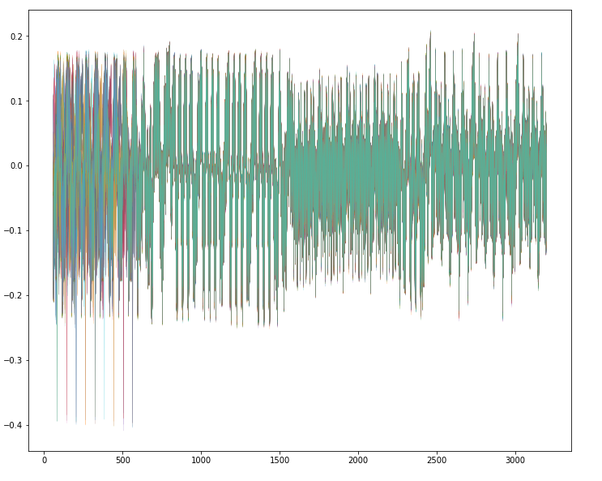
Alignment

Slide 13
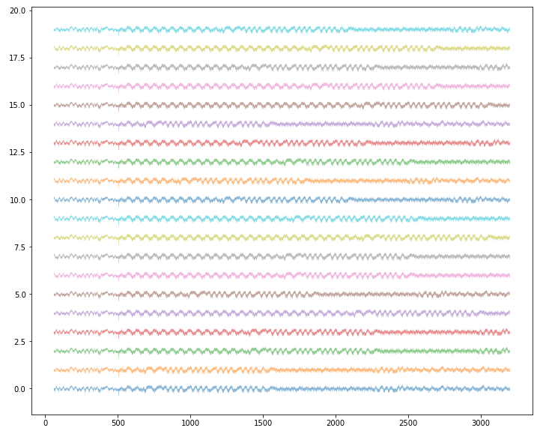
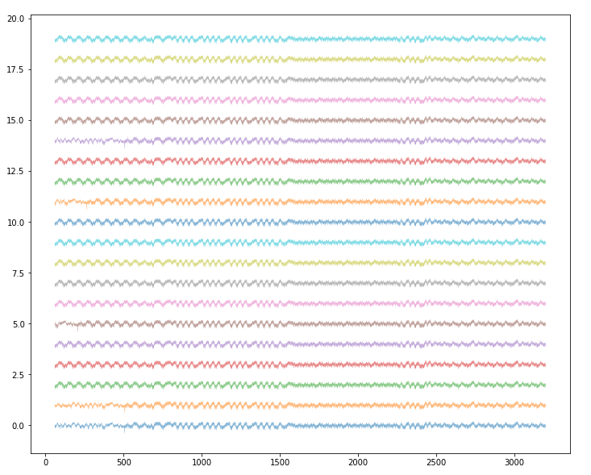
Alignment
Result key: 1iVe Y0u|2 Dr3@M

Slide 14
Team
David Zashkolnyi (team leader)
Natalya Markina
Renata Mustafina
Mary Lyashenko
Viktoria Tabas
Danil Kovalenko
Arthur Zhilka
Sergiy Bilyk

